Slide 1


Introduction to Hindi to English translation
Hindi to English translation plays a crucial role in bridging linguistic gaps and facilitating effective communication. It involves conveying the meaning and essence of the source text into English while preserving cultural nuances and idiomatic expressions.

Slide 2
Importance of Hindi to English translation
Global Communication
Business Expansion
Enables communication with a wider audience and global market.
Facilitates entry into English-speaking markets and international collaborations.
Access to Knowledge
Cultural Exchange
Allows access to a vast repository of English language resources and information.
Promotes cross-cultural understanding and sharing of ideas and perspectives.

Slide 3
Overview of Translation Tools and Software
Translation Software
Online Translation Platforms
Mobile Translation Apps
Translation software like SDL Trados and MemoQ offer advanced features for professional linguists.
Online platforms like Google Translate and Microsoft Translator offer quick and convenient translation services.
Mobile apps like iTranslate and Microsoft Translator enable on-the-go translation for travelers and international businesses.
They provide terminology management, translation memory, and machine translation capabilities.
They allow instant translation of text, websites, and documents.
They offer features like offline translation and voice recognition.

Slide 4

Advantages of using a translation tool
Accuracy: Translation tools ensure accurate interpretation of content.
Efficiency: Saves time and effort with speedy translation results.
Versatility: Capable of translating various content types like text, audio, and images.

Slide 5
Tips for Accurate Translation
Understanding Context
Research Cultural Nuances
Context is crucial for accurate translation. Understand the larger meaning behind the words.
Be aware of cultural references and nuances to ensure accurate translation.
Use Professional Translators
Proofread and Edit
For complex documents, rely on professional translators to ensure accuracy.
Always proofread and edit the translated content to catch any errors.

Slide 6

Future of Hindi to English translation
1
Advancements in Machine Translation
Machine learning and AI will enhance translation accuracy and speed.
2
Integration with Voice Recognition
Translation tools will seamlessly work with voice command and speech-to-text technology.
3
Real-time Collaboration and Remote Translation
Translation software will enable real-time collaboration and remote interpretation services.

Slide 7




Key features of our Translator
Accurate Translation
Fast Translation
Versatile Usage
User-friendly Interface
Precision and reliability in translating from Hindi to English.
Efficient and quick translation of text with minimal turnaround time.
Capable of translating various document types and content categories.
Intuitive design for seamless and easy translation experience.

Slide 8
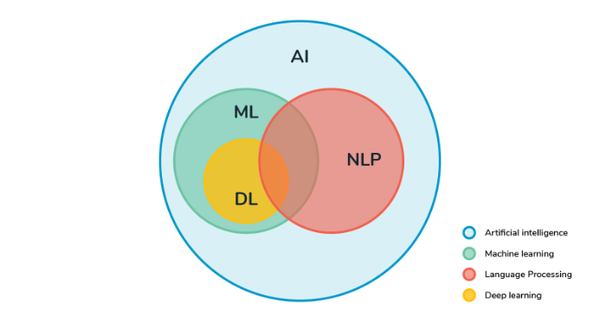
Speciality of our translator
Our translator utilizes advanced machine learning algorithms to ensure accurate and contextual translations.
It employs sophisticated language models for precise conversion of idiomatic expressions.
Additionally, it offers real-time feedback on grammar and syntactical errors.

Slide 9
Conclusion and key takeaways
In conclusion, Hindi to English translation plays a crucial role in bridging language barriers. It enables global communication, cultural exchange, and business growth. With our advanced translator, accuracy, efficiency, and quality are guaranteed.
Key takeaways include the significance of accurate translation, the impact on international relations, and the potential for expanding opportunities across various sectors.

Slide 10


